Slide 1


APRIL 2026
Terrain-aware model-predictive path integral control
M E 177K Final Deliverable
Akhil Gharpurey
Undergraduate Research Assistant – Bakolas Research Group
Department of Aerospace Engineering and Engineering Mechanics, The University of Texas at Austin

Slide 2
Contents
Overview
Model-Predictive Path Integral Control
Dynamic Obstacle Handling
Terrain Perception and Evaluation
Simulation and Results
2

Slide 3
Introduction
Introduction to Autonomous Navigation and Path Planning

Slide 4
Overview
Aim to solve the autonomous navigation problem
Goal: reach a desired position from a given start position while minimizing some performance index
Problem extends to various applications, such as package delivery and planetary navigation
4

Slide 5
Existing Solutions (1)
Path Planning Algorithms [1]
A*: Finds optimal path from start to end goal via heuristics
Does not do any local online motion planning
Figure 1: A* Path Planning Implementation
5

Slide 6
Existing Solutions (2)
Reinforcement Learning [1]
Iteratively learns the correct path to take
Difficult to deploy in real-time scenarios
Figure 2: RL Path Implementation
6

Slide 7
Enabling Online Motion Planning
Aim: Derive a trajectory and track it in real time while approaching goal position
Need real-time control algorithm which can perform this task
7

Slide 8
Model-Predictive Control (MPC)
MPC optimizes a control sequence generated over a finite time horizon
Generates local trajectory and computes the optimal control input to apply to the system dynamics
Figure 3: MPC Implementation in Autonomous Racing
8

Slide 9
MPC - Mathematical Formulation
For linear systems, this reduces to an iterative QP problem [2]
9

Slide 10
Stochastic MPC and MPPI (1/2)
Baseline MPC assumes perfect knowledge of state and control input
No ability to handle noise
Stochastic MPC (SMPC) methods are necessary for noise/disturbance rejection
10

Slide 11
Stochastic MPC and MPPI (2/2)
First and second order methods are often employed to solve SMPC problems
May converge to local minima not equal to the true minimum [3]
Zero order sampling-based methods are often used to alleviate this
11

Slide 12
MPPI Control
What is MPPI?
MPPI Control Problem Formulation
MPPI Solution Algorithm
Deployment in Static Environments

Slide 13
Introduction to MPPI
Zero-order algorithm for solving SMPC problems
Samples several input perturbations in parallel and optimizes the set of trajectories instead of iterating on one sequence
13

Slide 14
General SMPC Problem Formulation
14

Slide 15
MPPI Solution Algorithm (1/2)
First generates M (≈ 10³−10⁴) input sequence perturbations around a nominal control sequence
Samples from Mixture-of-Gaussians (MoG) with zero mean and covariance
Nominal control sequence is initialized at zero
Computes cost for each perturbed control sequence according to cost functional J(x,u) where x is the trajectory generated by the control sequence u
15

Slide 16
MPPI Solution Algorithm (2/2)
Weights each control sequence according to cost relative to minimum
Optimal Control Input is computed as weighted sum of perturbations
16

Slide 17
MPPI with Static Obstacle Handling
Apply additional constraint to optimization problem
Denote Xk,rbt as the space comprised of the robot geometry, Xobs as the space comprised of all obstacles in the given environment
Becomes a soft constraint with large penalty in simulation
17

Slide 18
Baseline MPPI – Deployment (1/4)
Deployed on a kinematic differential drive model with dynamics
State Vector: xk = [x y θ]k
Control Input Vector: uk=[vl vr]k
18

Slide 19
Baseline MPPI – Deployment (2/4)
Generated 20,000 samples with 40 time horizon steps
Environment is a corridor with width 8.0 m and length 28.0 m
10 static circular obstacles are randomly placed throughout the environment
Initial position: (0.0, 0.0); Goal position: (0.0, 20.0)
19

Slide 20
Baseline MPPI – Deployment (3/4)
Cost evaluation of samples is parallelized on a CUDA kernel
Ran on 16-core 13th Generation Intel i7-1360P and NVIDIA RTX 3050 GPU with 4GB VRAM and 32GB RAM
Achieved computation time of 5 ms per step (200 Hz control frequency)
Figure 4: Baseline MPPI Implementation
20

Slide 21
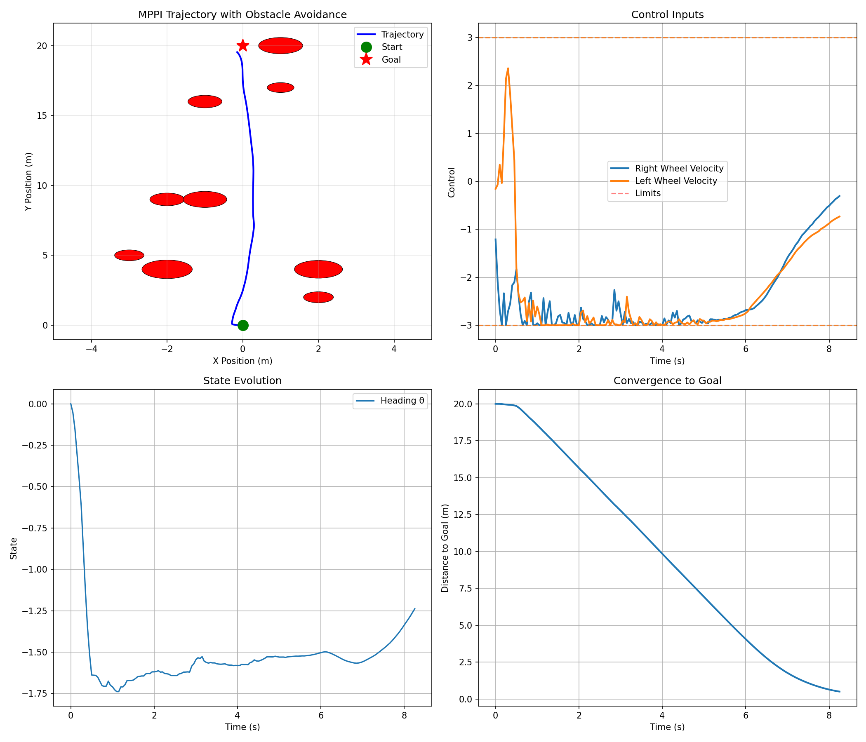
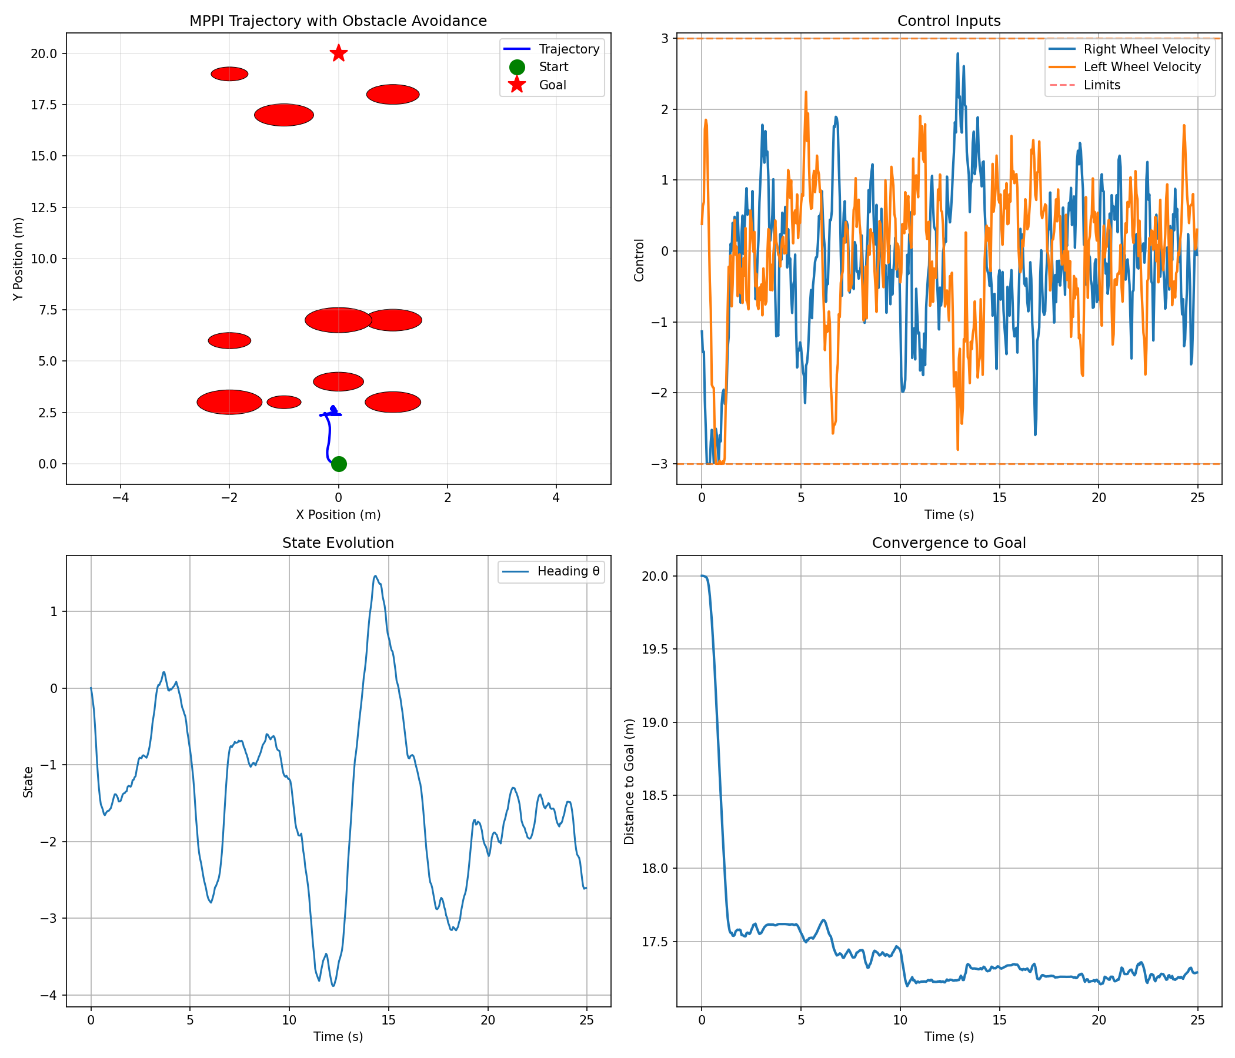
Baseline MPPI – Deployment (4/4)
Observed some undesired behavior; ex. backwards motion (left), entrapment (right)
Figure 5: Baseline MPPI Simulation exhibiting Backwards Motion
Figure 6: Baseline MPPI Simulation exhibiting Entrapment
21

Slide 22
Robust Mppi in dynamic environments
Avoiding Entrapment through Real-Time Covariance Adaptation
Dynamic Obstacle Handling

Slide 23
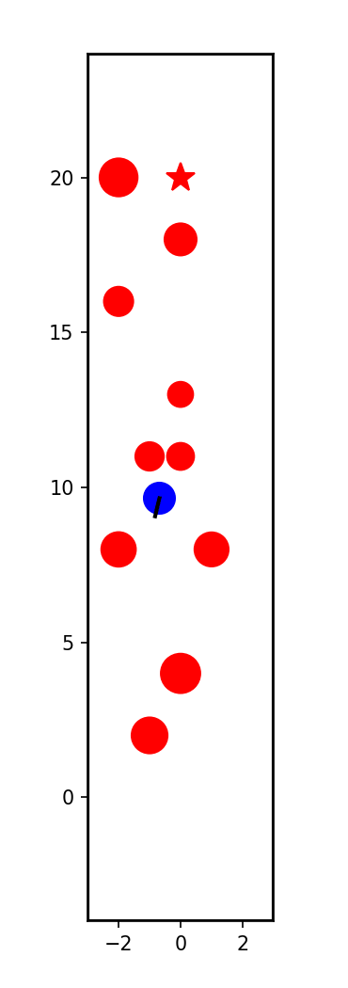
Entrapment Problem
Robot experiences a “trap” where it is surrounded by obstacles
Unable to derive a solution which continues navigation towards goal
Mathematical Definition:
Figure 7: Entrapped robot
23

Slide 24
Solution to Entrapment
Aim to increase the probability of generating an escape trajectory
Solution A (trivial): Increase M
Solution B: Increase perturbation covariance Σ when close to obstacles
Increasing the number of samples increases computational load so we opt for solution B
24

Slide 25
Covariance Adaptation (1/2)
Manipulating covariance based on presence of obstacles yields higher escape probability
Proof Linked Here
Discriminate generated trajectories as “safe” or “unsafe”
Safe: away from obstacles all time steps
Unsafe: near an obstacle at some time step
25

Slide 26
Covariance Adaptation (2/2)
For each rollout, derive the danger D
Update covariance based on observed danger with a maximum threshold μmax
26

Slide 27
Dynamic Obstacle Modeling (1/2)
Model dynamic obstacles after low-fidelity humanistic motion
Assumptions: constant speed, direction changing follows first-order steering dynamics
27

Slide 28
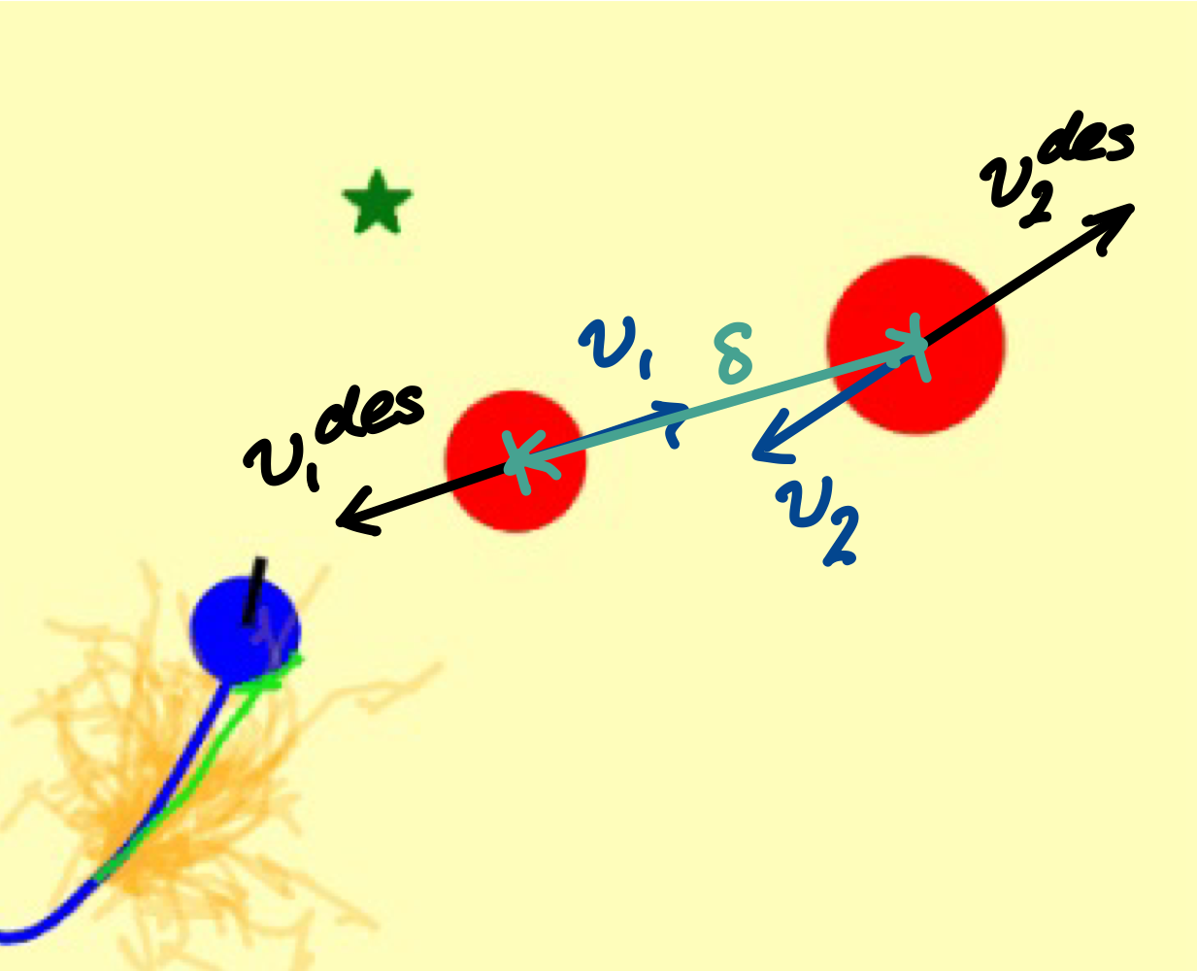
Dynamic Obstacle Modeling (2/2)
Probabilistically changes direction with a probability α = 0.05
Incorporate inter-obstacle collision avoidance
Set desired velocity based on repulsion
Figure 8: Repulsion between Neighboring Obstacles
28

Slide 29
Dynamic Obstacle Handling
Utilize Monte Carlo rollout sampling to generate R predicted obstacle trajectories over the same time horizon (R ∈ [40, 50])
Evaluate costs across all obstacle rollouts for each robot trajectory
Obstacle trajectory prediction takes current position and velocity as inputs
R is kept small to prevent large computational overhead while maintaining robust prediction capabilities
29

Slide 30
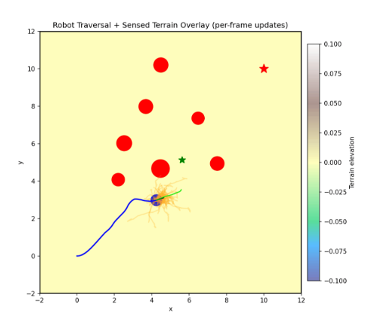
Simulation of Dynamic MPPI (1/2)
Deploy in square environment with start position (0,0) and goal position (10,10) to allow obstacles room to traverse
Create 7 obstacles with a speed of 1.34 m/s (human walking pace) and randomized initial positions and headings
Obstacles have robot avoidance strategy by treating robot as neighboring obstacle
Figure 9: Robust Dynamic MPPI Implementation in Superflat Terrain
30

Slide 31
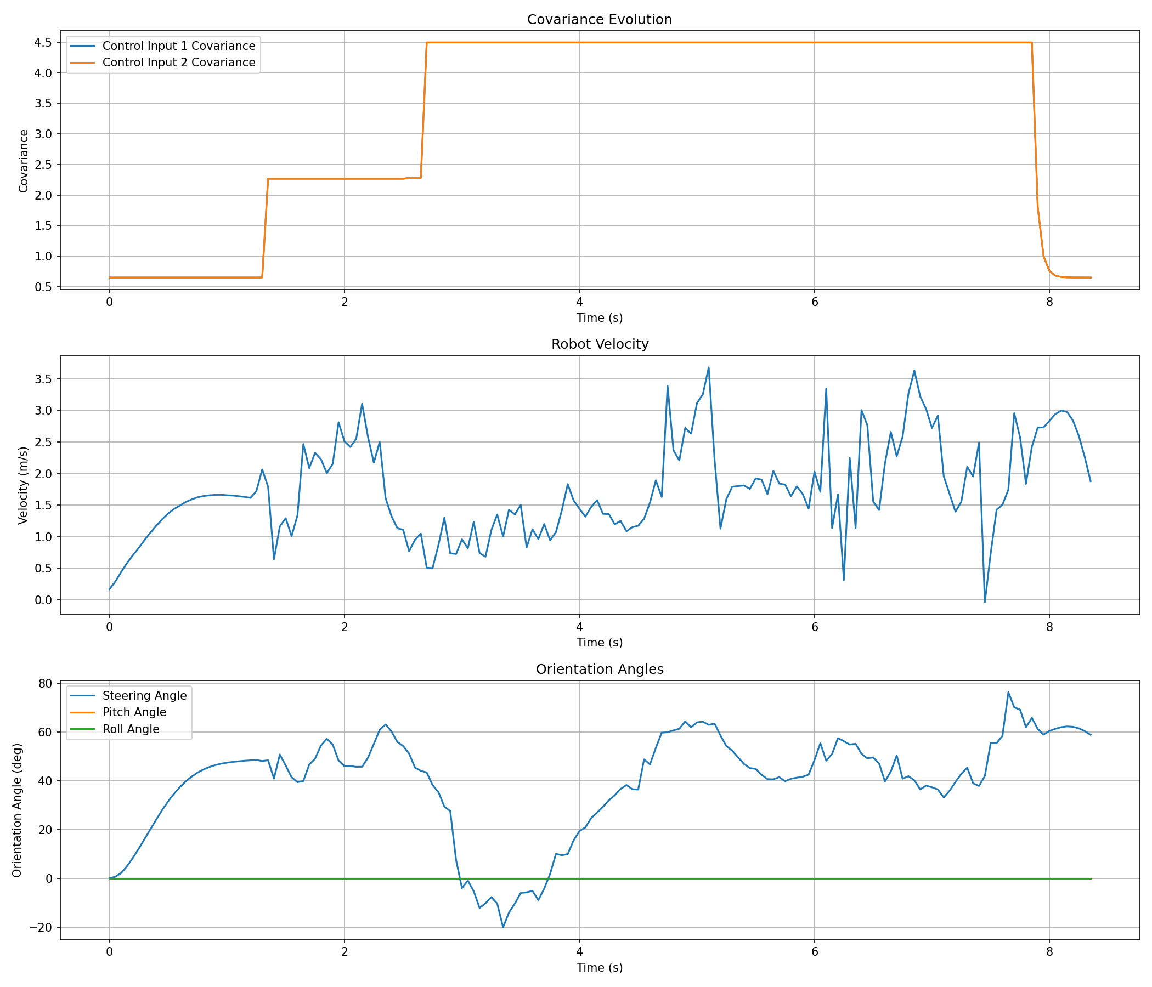
Simulation of Dynamic MPPI (2/2)
Step solve time of 0.028 seconds for 7 obstacles, 50 rollouts, and 15000 samples => control frequency of 36 Hz
Average collision probability = 0.10
Taken by computing complement of proportion of safe trajectories
Figure 10: Velocity, Covariance, and Orientation over Time
31

Slide 32
Terrain awareness in mppi control
Quantitative Terrain Evaluation via Digital Elevation Map Rendering
Qualitative Terrain Evaluation via Bayesian Classification
Robust Navigation via Waypoint Heuristics

Slide 33
Quantitative Terrain Evaluation (1/4)
In terraneous environments, robots may be prone to slip or excess battery/fuel consumption
Need a method for optimizing path across terrain
Goal: Acquire understanding of local terrain and determine terrain cost
33

Slide 34
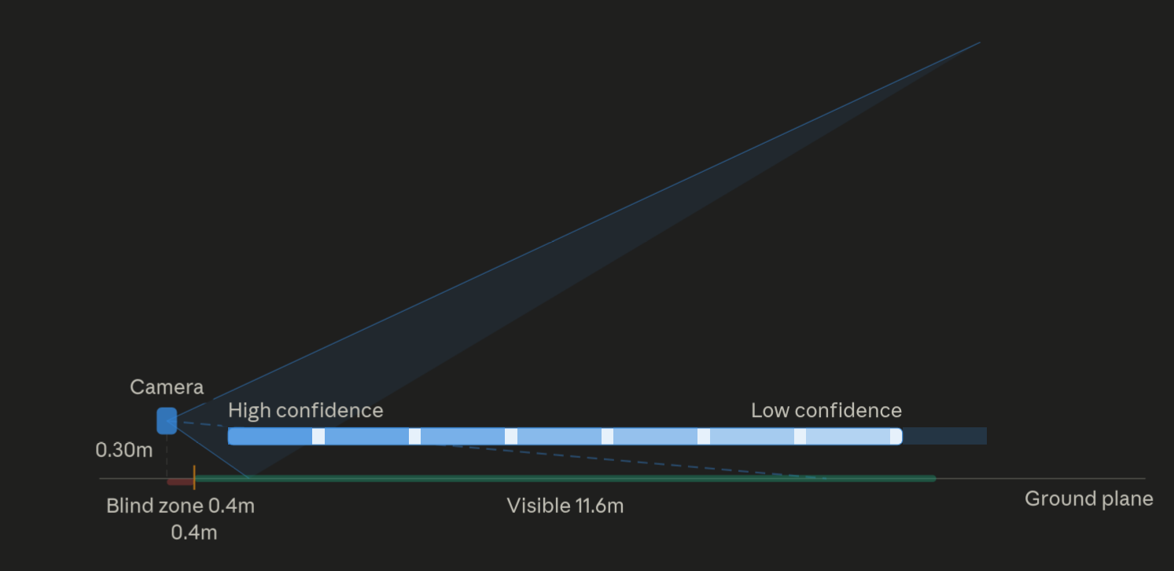
Quantitative Terrain Evaluation (2/4)
How do we acquire terrain knowledge?
Simulate visual sensor (camera)
Extract square images with a specified horizontal FOV angle and vertical FOV
Performs parallelized ray marching algorithm to find all intersections with terrain
Generates local point of view of terrain with noisy elevation and slope estimates
Figure 11: Camera sensor optics (generated by Claude Opus 4.6)
34

Slide 35
Quantitative Terrain Evaluation (3/4)
Derive digital elevation map (DEM) from camera point cloud
Camera point cloud → continuous patches “stitched” together
Slope and roughness are computed for each patch
For patches repeatedly observed, the DEM fuses each observation and increases confidence and precision for each patch estimate
35

Slide 36
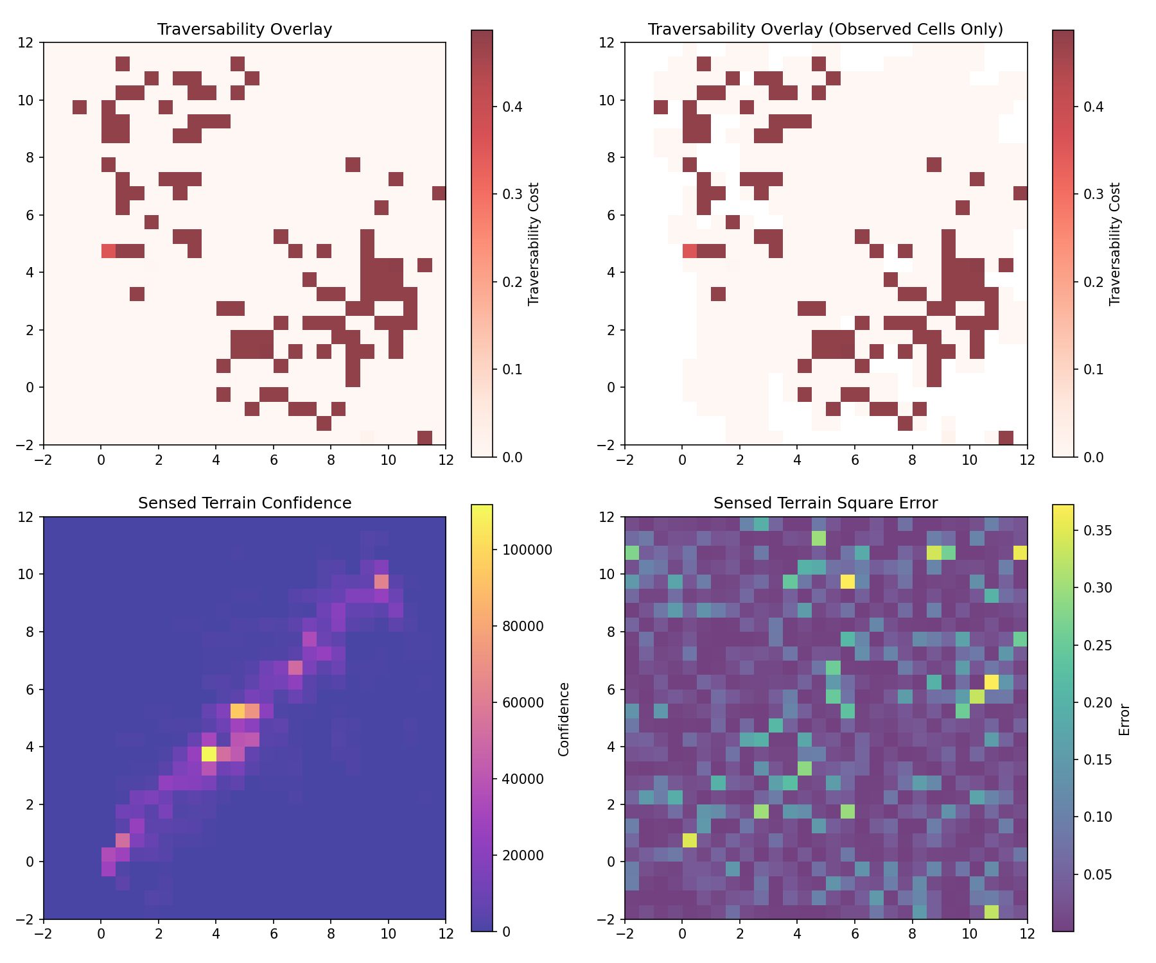
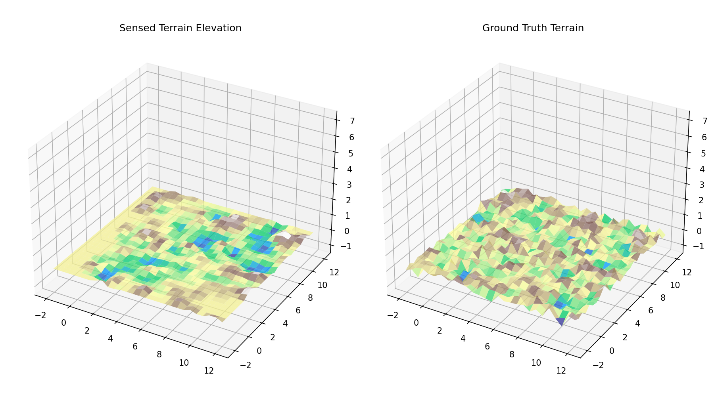
Quantitative Terrain Evaluation (4/4)
Using DEM estimates, acquire a costmap of the terrain
Figure 13: Observed Costmap, Confidence, and Error
36
Figure 12: Rendered Digital Elevation Map vs. Ground Truth

Slide 37
Qualitative Terrain Evaluation (1/3)
Quantitative (DEM) approach only provides soft constraint – could be insufficient for fully preventing robot tip-over
Goal: mask out dangerous terrain such that the robot navigates on traversable terrain exclusively
Approach: Bayesian classification of terrain patches
37

Slide 38
Qualitative Terrain Evaluation (2/3)
Define 8-dimensional feature vector of each patch
Using Bayes’ Theorem, determine probability of belonging to each class
Ci = class, P(Ci|v) = posterior probability, P(v|Ci) = likelihood, P(Ci) = prior, P(v) = evidence
38

Slide 39
Qualitative Terrain Evaluation (3/3)
Obtain class priors by bootstrapping the algorithm
Classifier uses a circular buffer to store simulated results for all cells in given terrain
Class means, variances, and priors are obtained
Bootstrapped results eventually get diluted by posterior estimates from online learning
Each cell is classified as traversable (zero cost multiplier), cautious (half cost multiplier), and non-traversable (full cost)
Costs of each cell class are added to terrain costmap
39

Slide 40
Waypoint-Heuristic Motion Planning (1/4)
Quantitative and qualitative terrain costmap introduces local minima located away from goal position
Covariance adaptation insufficient for driving robot away from terrain-driven minima
Need robust method of driving robot towards goal incrementally, discouraging settling at local minima
Proposed solution: create a waypoint heuristic which selects subgoals along the robot’s way towards the goal
40

Slide 41
Waypoint-Heuristic Motion Planning (2/4)
Setup: lay out local grid with robot at center with 2k+1 nodes in each row and column
Heuristic is weighted sum of progression towards goal (π), terrain costmap (Qtr), and obstacle aversion
41

Slide 42
Waypoint-Heuristic Motion Planning (3/4)
Path-integral procedure is applied for deriving optimal waypoint coordinates
The optimal waypoint is treated as goal position until robot reaches it
Forces waypoint recalculation
42

Slide 43
Waypoint-Heuristic Motion Planning (4/4)
Weights determine priority of constraint
For large βp, we prioritize progress towards the goal
For large βo, we heavily prioritize obstacle avoidance
May observe subgoal recalculation if intercepted by obstacle
For large βt, we prioritize traversing safe terrain
Figure 14: Waypoint Heuristic Diagram with Minimizer (red) and Optimal Waypoint (blue)
43

Slide 44
Simulations and results
Algorithm Demonstration
Computational Evaluation
Future Work

Slide 45
Algorithm Block Diagram
Obstacle Motion
Classify Terrain Traversability
Bootstrap Bayes Classifier
Sense Terrain with Camera
Build costmap, port to cost function
MPPI Control
Robot Dynamics
Create/Render Digital Elevation Map
Figure 15: Fully Integrated Algorithm Block Diagram
45

Slide 46

Simulation Example (1/5)
Figure 16: Bird’s Eye View of Hilly Terrain Simulation
Figure 17: Camera POV of Hilly Terrain Simulation
46

Slide 47
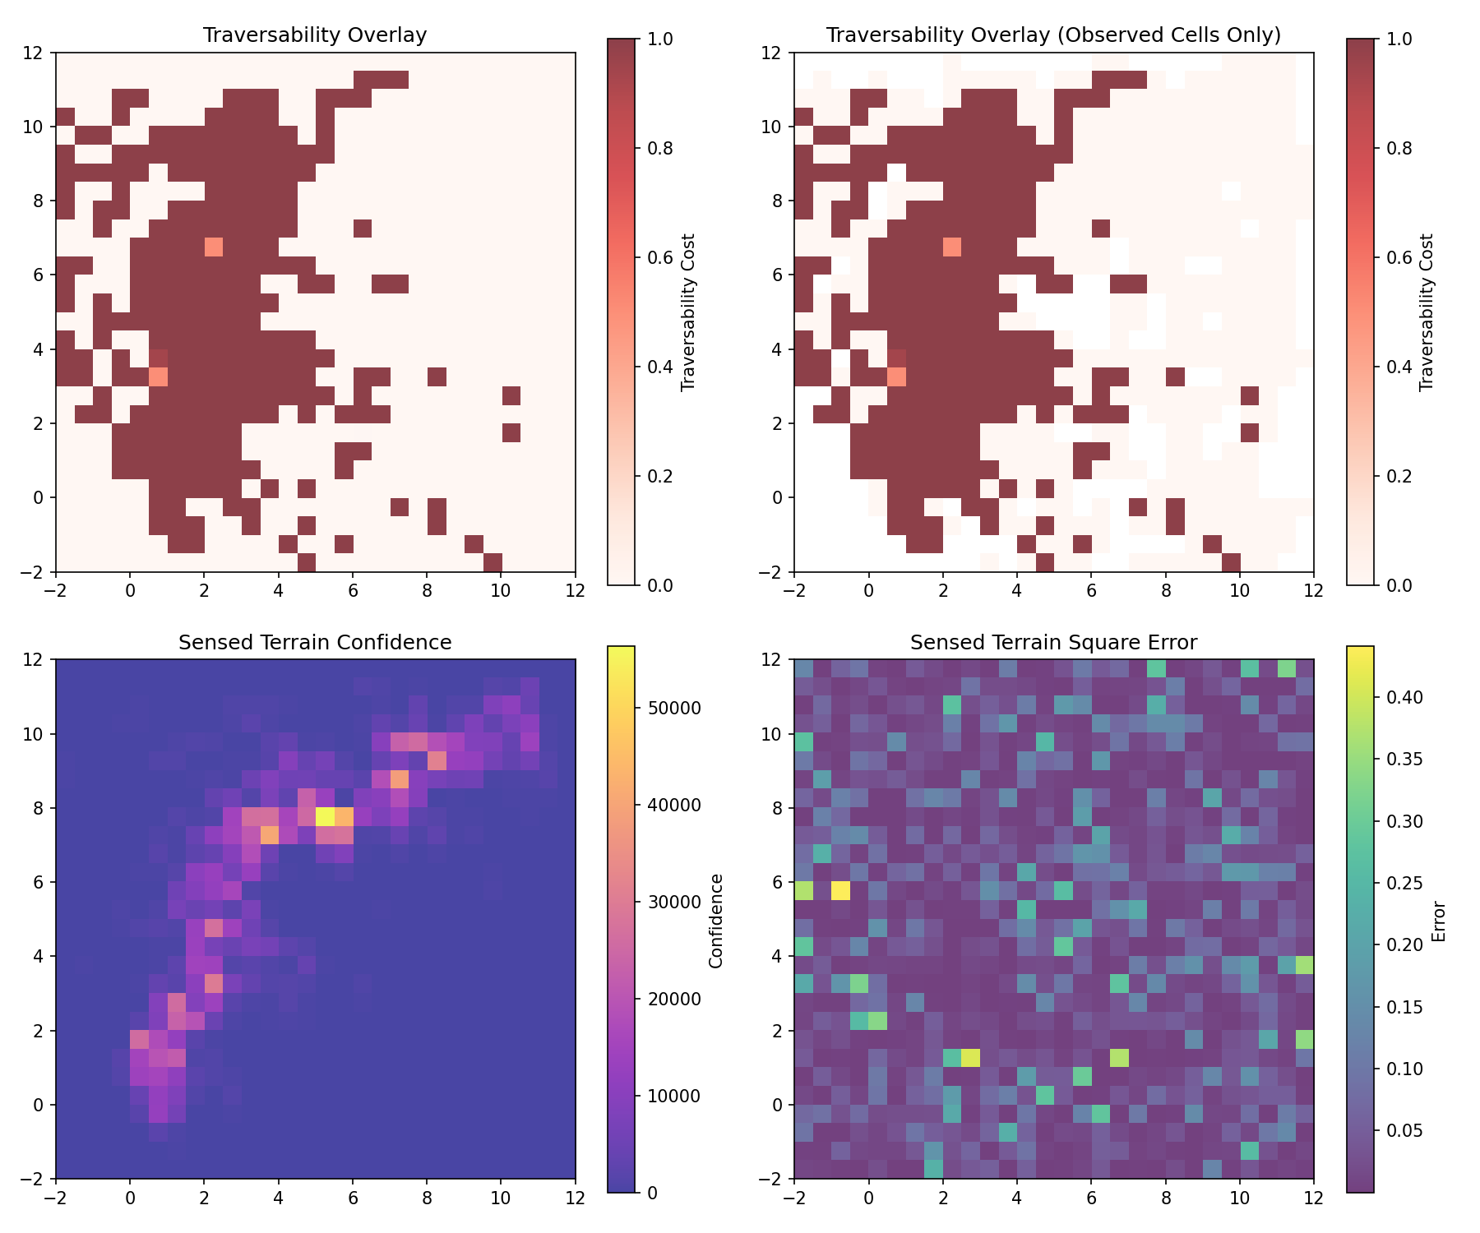
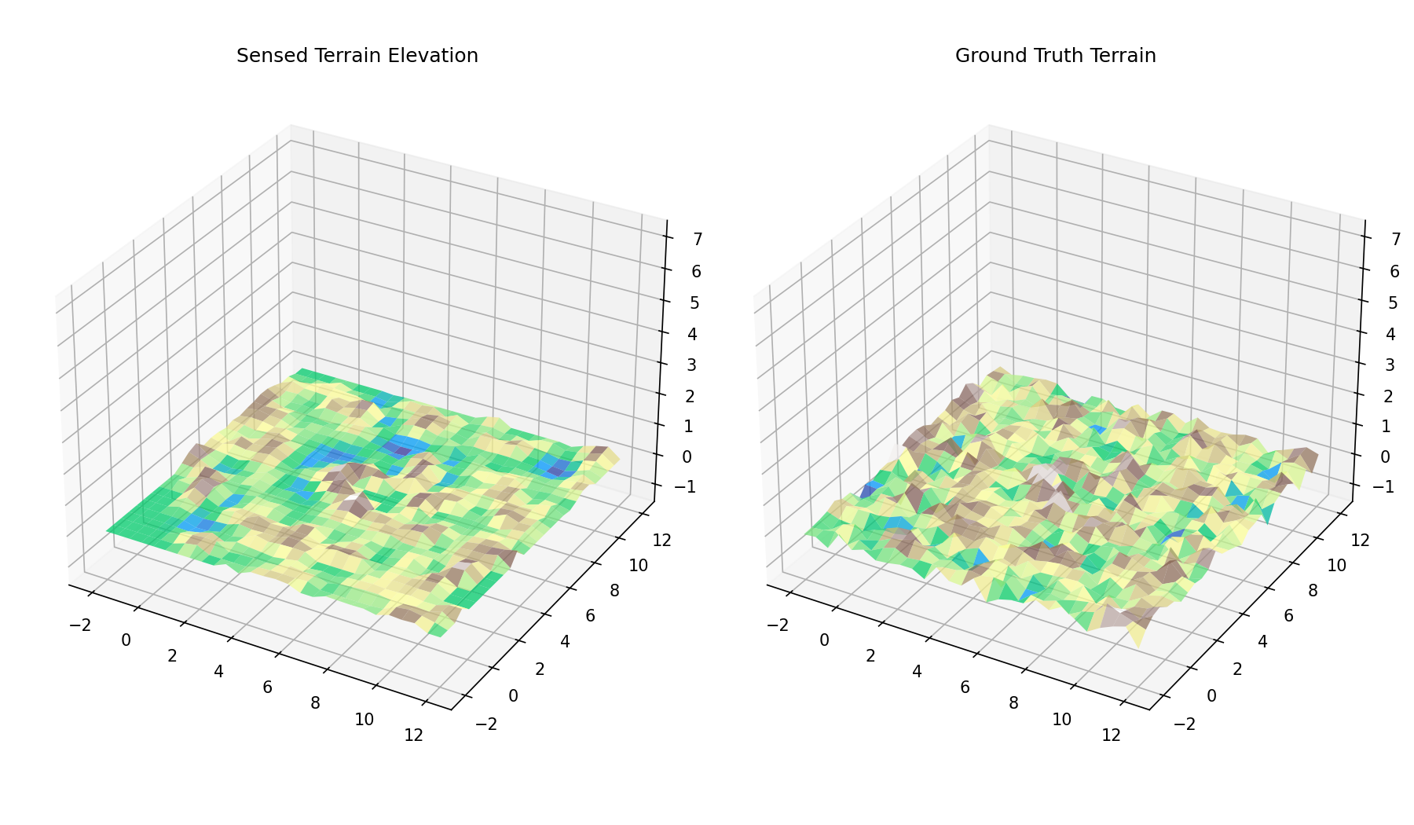
Simulation Example (2/5)
Figure 19: Rendered Digital Elevation Map
Figure 18: Hilly Terrain Observed Costmap with Confidence and Error Shown (online learning time per step = 4.9 ms)
47

Slide 48
Simulation Example (3/5)
Figure 20: Bird’s Eye View of Rough Terrain Simulation
Figure 21: Camera POV of Rough Terrain Simulation
48

Slide 49
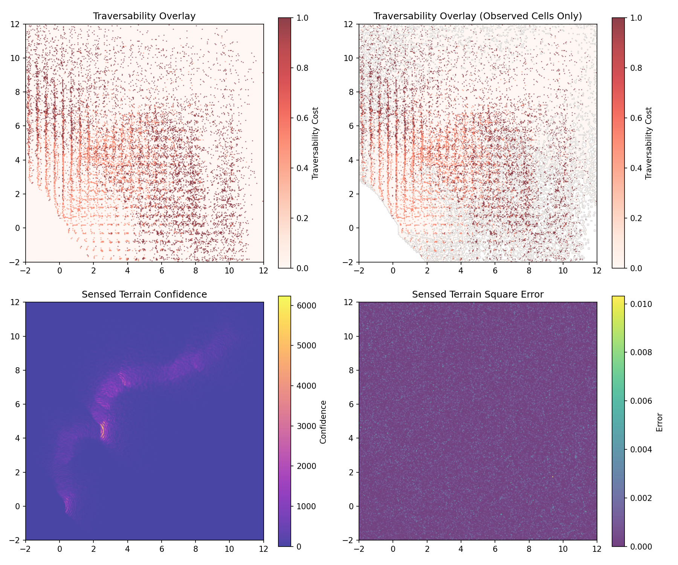
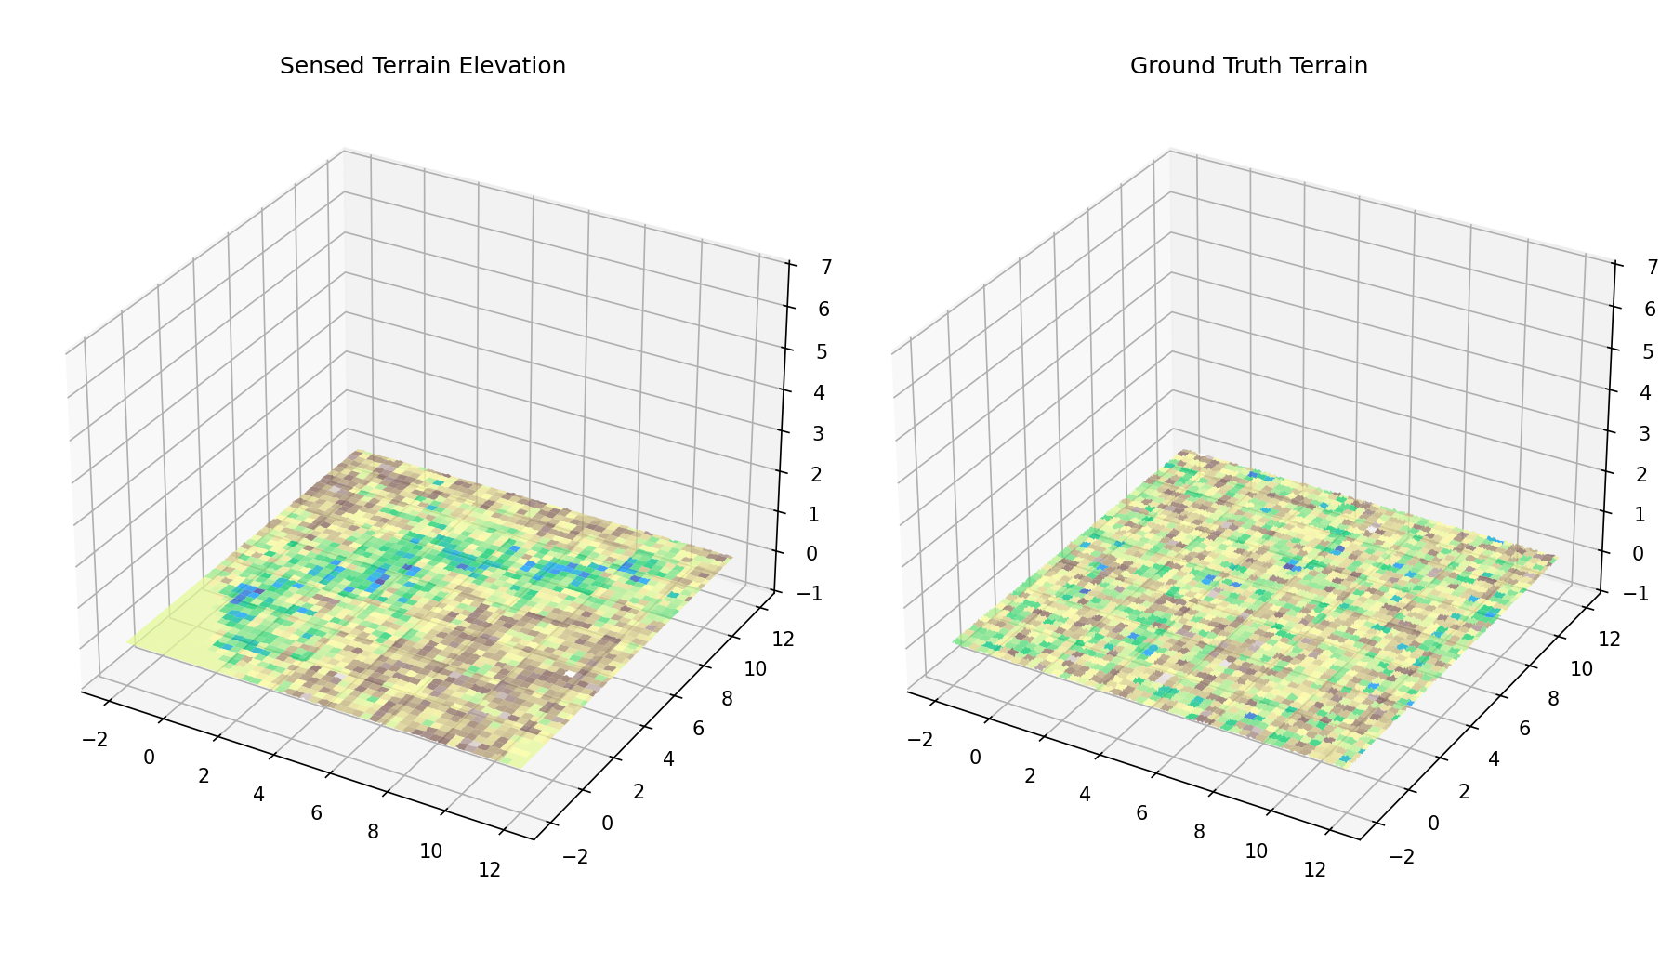
Simulation Example (4/5)
Figure 23: Rendered Digital Elevation Map
Figure 22: Rough Terrain Observed Costmap with Confidence and Error Shown (online learning time per step = 4.9 ms)
49

Slide 50
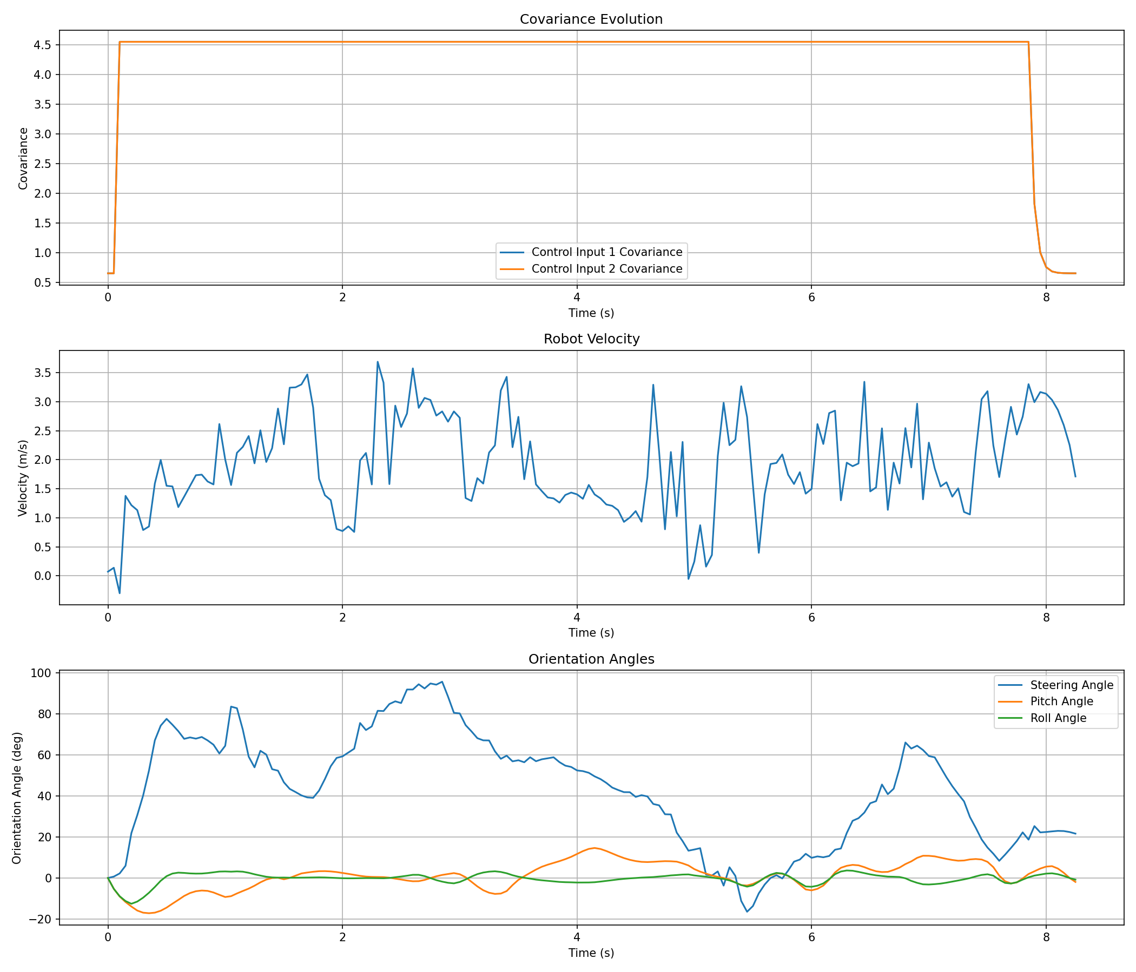
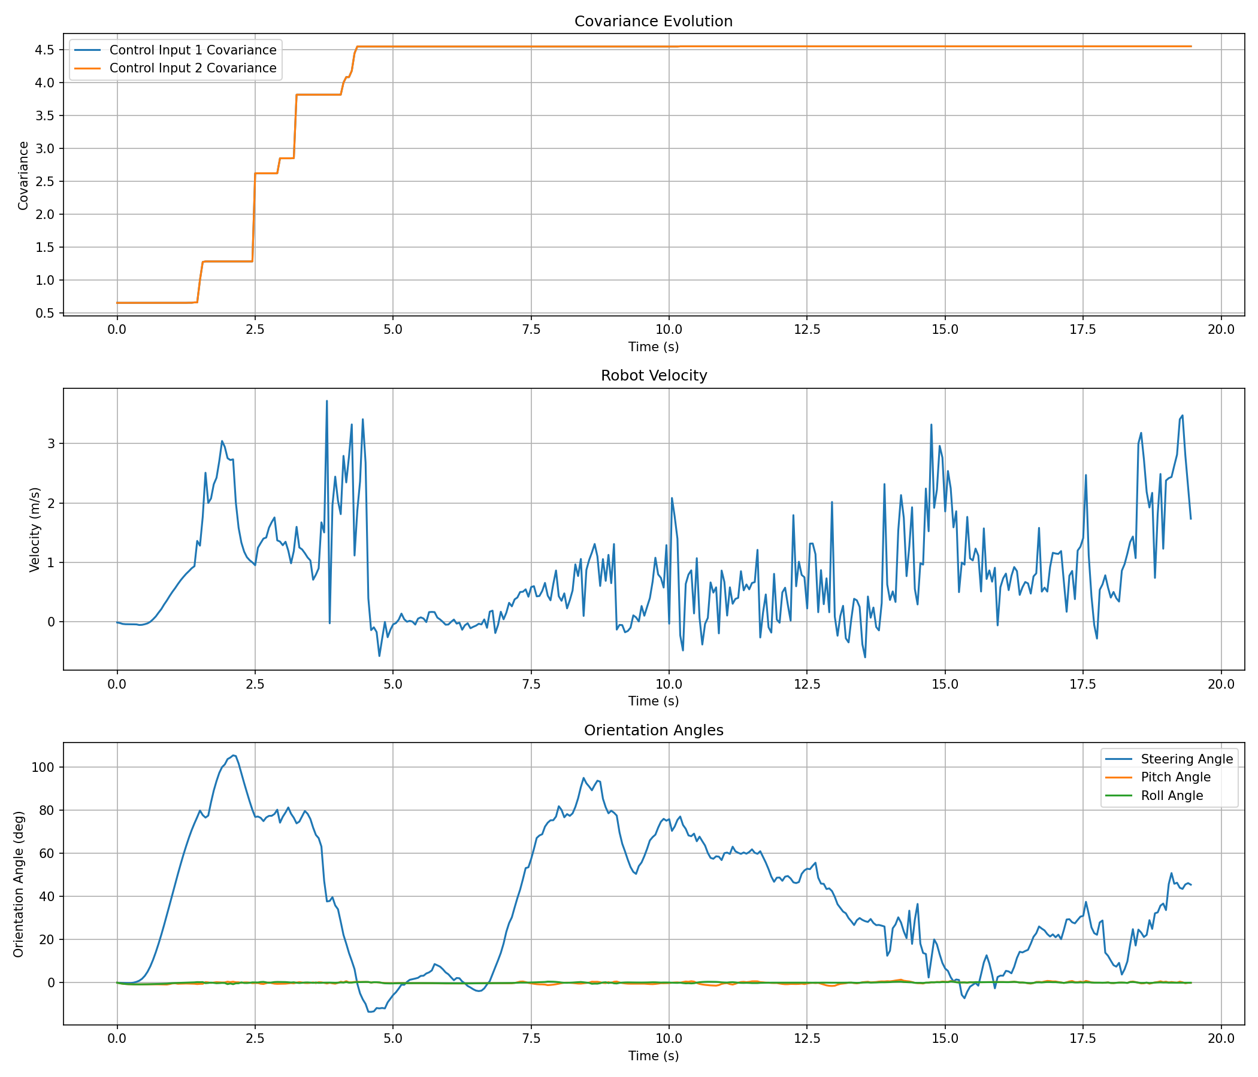
Simulation Example (5/5)
Figure 24: Covariance, Velocity, and Orientation over Time in Hilly Terrain
Figure 25: Covariance, Velocity, and Orientation over Time in Rough Terrain
50

Slide 51
Results
Simulations were conducted with 15,000 samples, 40-step time horizon at Δt = 0.05 s, and 8 obstacles (7 dynamic, 1 static)
Achieved MPPI solve step time of 30.6 ms and online learning of 5-6 ms (rougher terrain → more cells to learn)
Total control loop frequency = 27.7 Hz
Exceeds real-time threshold frequency of 20 Hz
Over 100 simulations, zero failures occurred via obstacle collision
Average safe trajectory rate = 0.877 → collision probability = 0.123
Maximum robot pitch = 19.8º, Maximum robot roll = 14.2º
51

Slide 52
Future Work
Eliminate omniscience in obstacle detection
Implement a method of observing dynamic obstacles on camera
Adjust computation time depending on number of observed static and dynamic obstacles
Develop and implement robust safety measures to guarantee safe navigation [5]
Accelerate obstacle computation to guarantee real-time performance [6]
52

Slide 53
Thank you!

Slide 54
References (1/2)
[1] Sangeeth Venu, Muralimohan Gurusamy, A comprehensive review of path planning algorithms for autonomous navigation, Results in Engineering, Volume 28, 2025, 107750, ISSN 2590-1230, https://doi.org/10.1016/j.rineng.2025.107750.
[2] A. Bemporad, M. Morari, V. Dua and E. N. Pistikopoulos, "The explicit solution of model predictive control via multiparametric quadratic programming," Proceedings of the 2000 American Control Conference. ACC (IEEE Cat. No.00CH36334), Chicago, IL, USA, 2000, pp. 872-876 vol.2, doi: 10.1109/ACC.2000.876624.
[3] Homburger, H., et al. "Optimality and Suboptimality of MPPI Control in Stochastic and Deterministic Settings," in IEEE Control Systems Letters, vol. 9, pp. 763–768, 2025.
54

Slide 55
References (2/2)
[4] R. Lacroix, "Autonomous Rover Navigation on Unknown Terrains Functions and Integration," in Experimental Robotics VII, 2001, pp. 501–510.
[5] Pedram Rabiee, Jesse B. Hoagg, "Guaranteed-Safe MPPI Through Composite Control Barrier Functions for Efficient Sampling in Multi-Constrained Robotic Systems," 2024.
[6] Steven Patrick, Efstathios Bakolas, "Path Integral Control with Rollout Clustering and Dynamic Obstacles," 2024.
55

